Slide 1
Module 08: SSISDB Catalog Settings

Slide 3
Agenda
Change default Catalog Settings ?

Slide 4
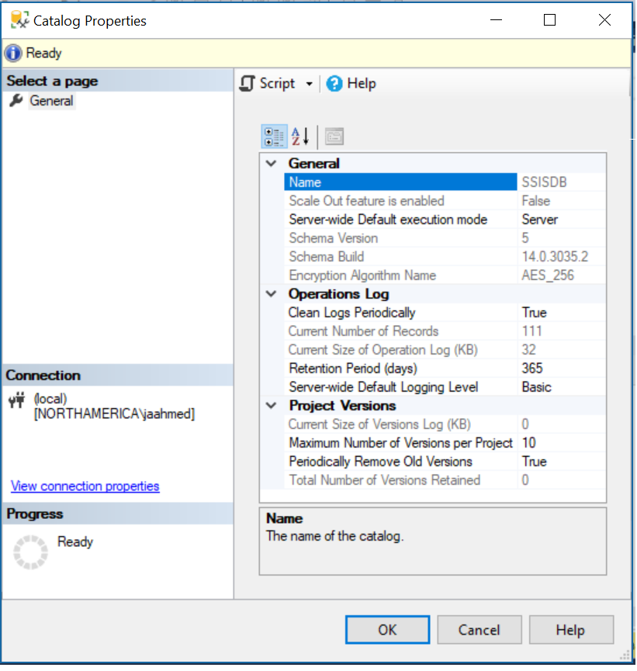
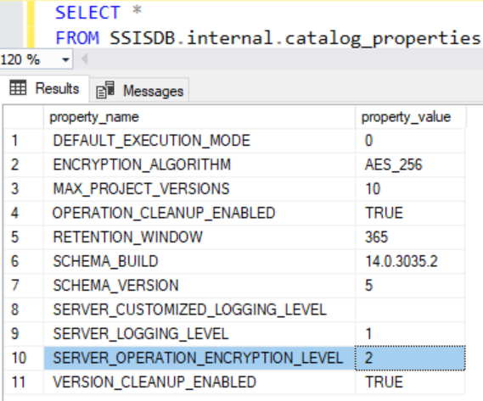
SSIS Catalog Settings
Not all settings are configurable from Catalog Properties interface
Configure directly in table SSISDB.internal.catalog_properties
Some new properties may not be in table and must be entered manually
Notes:
Not all settings are configurable from Catalog Properties interface
eg: SERVER_OPERTION_ENCRYPTION_LEVEL
Some property_name are not in the catalog_properties table and must be entered in manually
* eg: VALIDATION_TIMEOUT

Slide 5
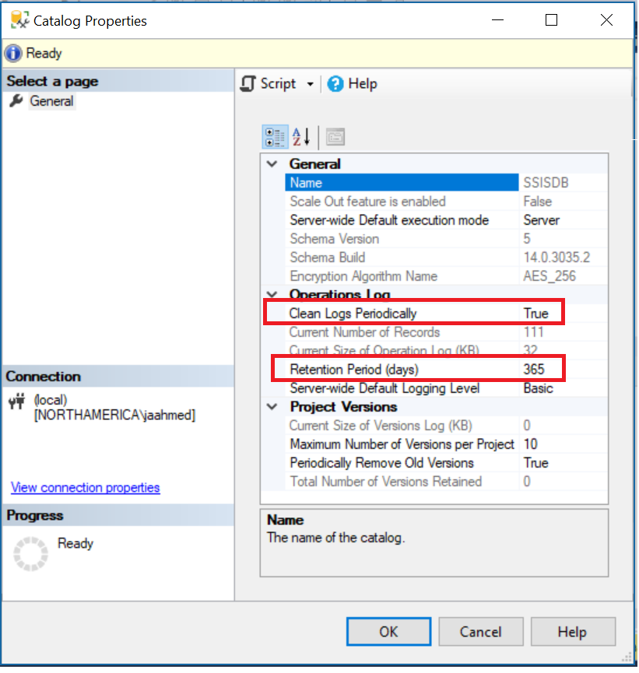
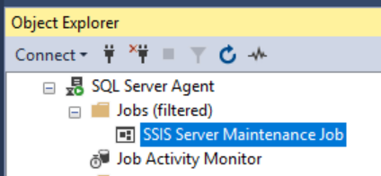
Log Retention Setting
If OPERATION_CLEANUP_ENABLED then delete log records greater than RETENTION_WINDOW
Stats also displayed:
Current Number of Records
Current Size of Operation Log (KB)
Notes:
This Job runs following stored procs for cleanup
EXEC [SSISDB].[internal].[cleanup_server_retention_window] which deletes the following
DELETE TOP (1000) [internal].[operations] WHERE [end_time] <= RetentionPeriod
delete from [internal].[operation_messages_scaleout] where operation_id = @execution_id
delete from [internal].[event_messages_scaleout] where operation_id =@execution_id
delete from [internal].[event_message_context_scaleout] where operation_id = @execution_id
DROP SYMMETRIC KEY MS_Enckey_Exec_@execution_id
DROP CERTIFICATE MS_Cert_Exec_@execution_id
EXEC [SSISDB].[internal].[cleanup_server_project_version] which deletes the following
DELETE [internal].[object_versions] Where > max_version_count

Slide 6
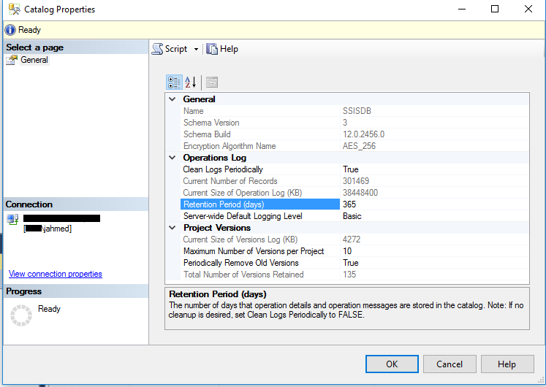
Set Retention Period accordingly
Notes:
Screenshot is using 38.4 GB in operations log history

Slide 7
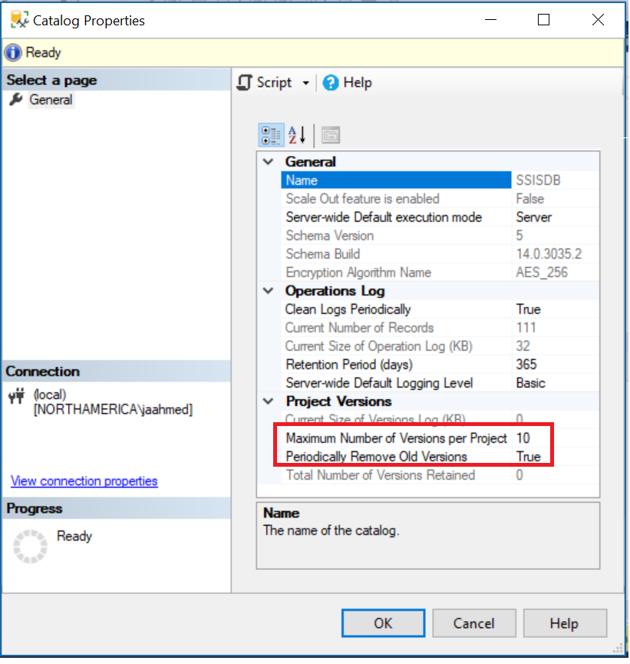
Project Version Removal
If VERSION_CLEANUP_ENABLED then delete project greater than
MAX_PROJECT_VERSIONS
Stats also displayed:
Current Number of Versions Retained
Current Size of Version Log (KB)
Notes:
This Job runs following stored procs for cleanup
EXEC [SSISDB].[internal].[cleanup_server_retention_window] which deletes the following
DELETE TOP (1000) [internal].[operations] WHERE [end_time] <= RetentionPeriod
delete from [internal].[operation_messages_scaleout] where operation_id = @execution_id
delete from [internal].[event_messages_scaleout] where operation_id =@execution_id
delete from [internal].[event_message_context_scaleout] where operation_id = @execution_id
DROP SYMMETRIC KEY MS_Enckey_Exec_@execution_id
DROP CERTIFICATE MS_Cert_Exec_@execution_id
EXEC [SSISDB].[internal].[cleanup_server_project_version] which deletes the following
DELETE [internal].[object_versions] Where > max_version_count

Slide 8
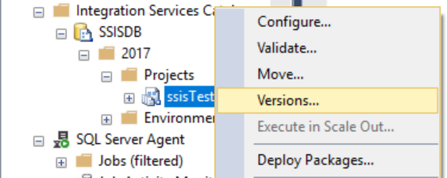
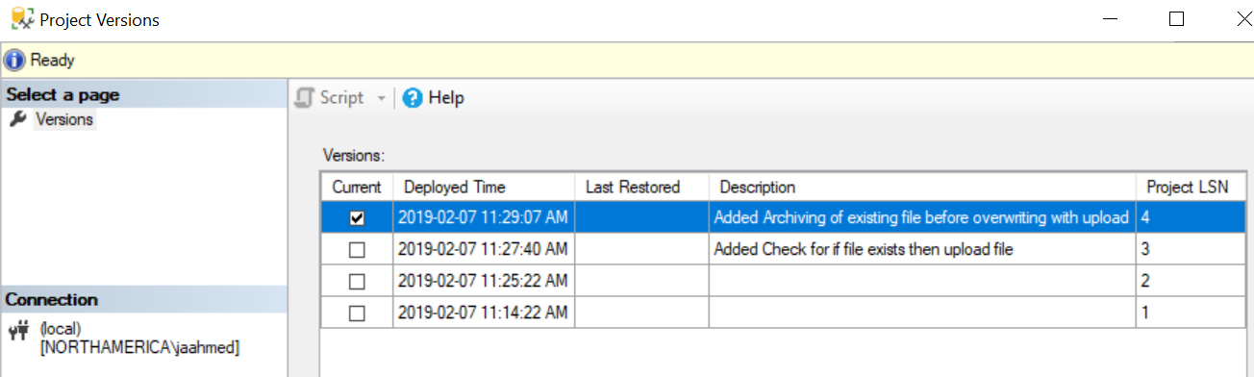
Viewing Project Versions

Slide 9
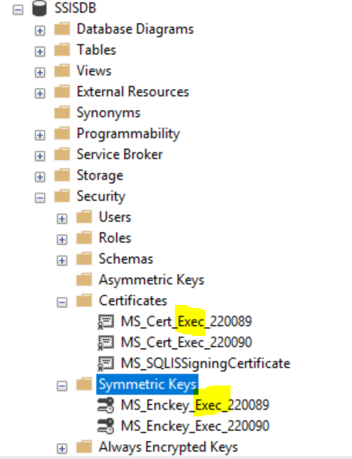
SERVER_OPERATION_ENCRYPTION_LEVEL …
Introduced in SQL Server 2012 SP2
Not configurable from UI
When the value is 1 (PER_EXECUTION), the certificate and symmetric key used for protecting sensitive execution parameters and execution logs are created for each execution.
1 was the default in SQL Server 2012
Notes:
Above screenshot is for same package executed twice times, which generated set of Certificates and Symmetric Keys for each Execution.
On a system that runs many packages that can SSIS package can fails to start due application lock timeout in SSISDB.catalog.create_execution when it is trying to create this Certificate and Symmetric Keys for each execution.
You will get following generic error reported by DTEXEC runtime:
Error: "The operation failed because the execution timed out. Source: .Net SqlClient Data Provider".

Slide 10
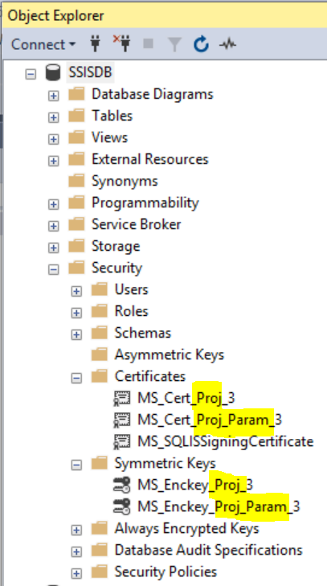
SERVER_OPERATION_ENCRYPTION_LEVEL …
When the value is 2 (PER_PROJECT), the certificate and symmetric key are created one time for each project.
Notes:
For system that run lots of packages this is recommended setting.
New SQL Server versions have this set to 2 as the default.

Slide 11
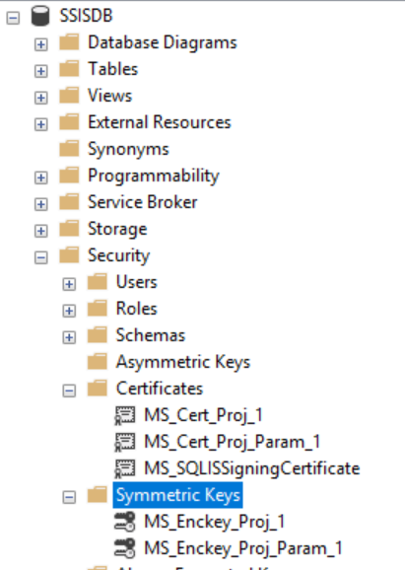
SERVER_OPERATION_ENCRYPTION_LEVEL …
Must run catalog.cleanup_server_log before changing SERVER_OPERATION_ENCRYPTION_LEVEL
From 1 to 2
From 2 to 1
To change follow instructions here.
Notes:
EXEC SSISDB.internal.cleanup_server_log
ALTER DATABASE SSISDB SET SINGLE_USER
--change SEVER_OPERATION_ENCRYPTION_LEVEL to PER_PROJECT (2) or PER_EXECUTION (1)
EXEC SSISDB.catalog.configure_catalog @property_name='SERVER_OPERATION_ENCRYPTION_LEVEL', @property_value='2'
ALTER DATABASE SSISDB SET MULTI_USER
--clean up transaction level keys.
EXEC SSISDB.internal.Cleanup_Server_execution_keys @cleanup_flag = 1

Slide 12
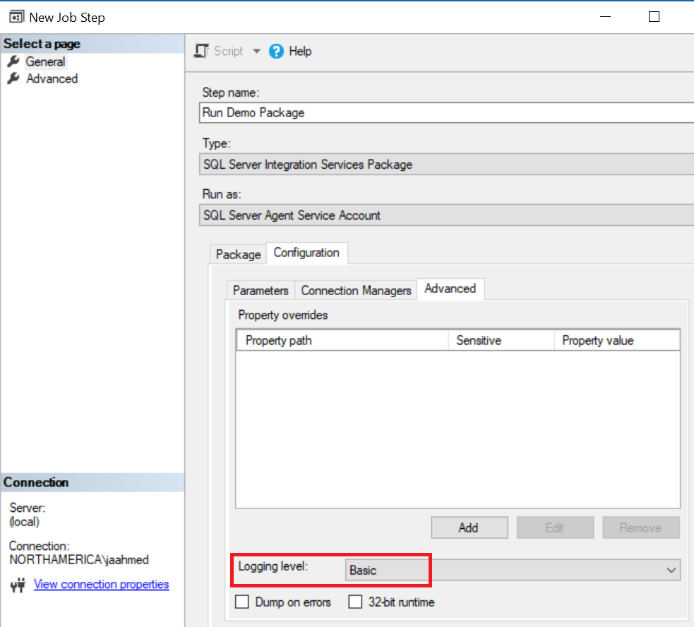
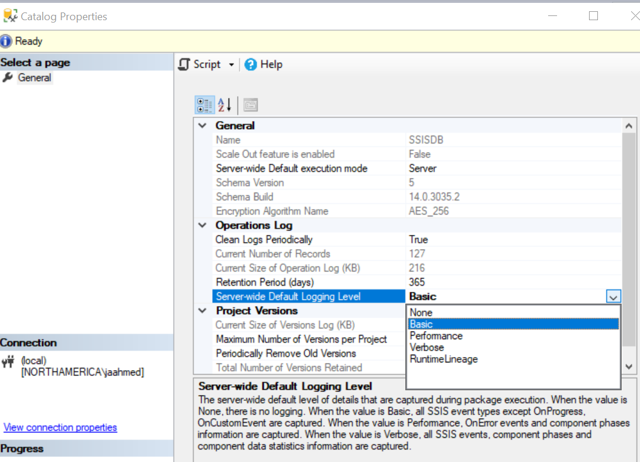
SERVER_LOGGING_LEVEL
Set default logging level for the Integration Services server
Sets the default logging when you create new SQL SSIS Job Steps
Notes:
TODO: documentation on RuntimeLineage

